Slide 1

Object oriented programming and methodology
AL-305
PRESENTATION ON:
Password Generator
Submitted To:
Ms. Rashmi Pandey
Assistant Professor
CSE Department
Submitted By:
Harshit Jain
0905AL231036
CS- AIML[3rd Sem]

Slide 2
Content:
Introduction
Abstract
Flow of your project
Code Implementation
Reference

Slide 3
Introduction
What is a Password Generator?
A tool that generates secure, random passwords to help users create strong passwords.
Random passwords are difficult to guess and improve security against unauthorized access.
Why is it Important?
With the increasing number of online accounts, using strong and unique passwords is crucial to protect sensitive information.
Password generators provide a quick, easy, and effective way to create secure passwords.
Generates Secure password without human error.

Slide 4
Abstract
Objective: The purpose of this project is to design a password generator that creates strong and secure passwords of specified lengths using a combination of uppercase letters, lowercase letters, digits, and special characters.
Main Features:
Random Password Generation: Passwords are generated using random selection from a predefined set of characters.
Customizable Length: Users can specify the length of the generated password.
Looped Functionality: The user can choose to generate more passwords in a loop until they decide to stop.
4

Slide 5
Flow of Password Generator
1.User Input (Length):
The program first prompts the user to input the desired length of the password.
2.Random Password Generation:
The program then generates a password using random characters chosen from a set that includes:
Lowercase letters (a-z)
Uppercase letters (A-Z )
Digits (0-9 )
Special characters (!@#$%^&*())
Reference No.: R1, R2
SELO: 1,2
5

Slide 6
Flow of Password Generator
3. Password Display:
The generated password is displayed to the user.
4. Loop for Multiple Passwords:
The program asks the user if they want to generate another password.
If the user chooses ‘y’ or ‘Y’, the process repeats.
If the user chooses ‘n’ or any other key, the program exits.
6

Slide 7
Flowchart of the Program
[Here, you can add a flowchart to visually represent the program flow.]
Start
Input Length
Generate Random Password
Display Password
Ask if Another Password is Required
If Yes → Repeat
If No → End
End
7

Slide 8
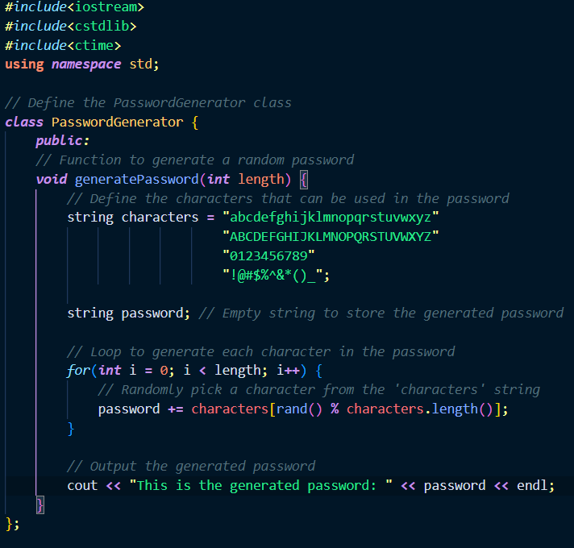
Code implementation
8

Slide 9
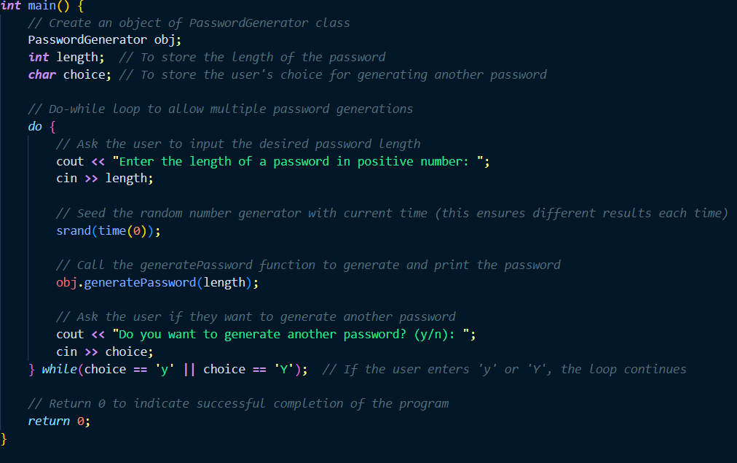

Slide 10

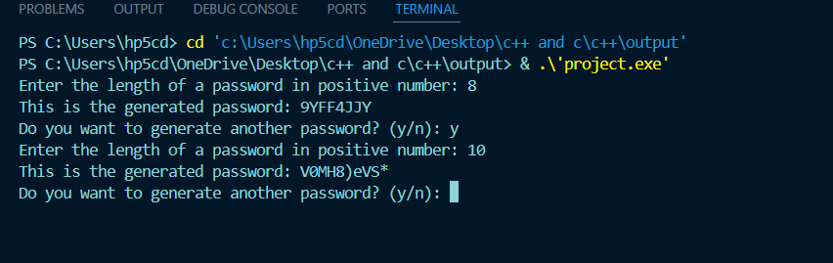
Output

Slide 11
Reference
https://www.w3schools.com
https://copilot.microsoft.com
ChatGPT

Slide 12


